Slide 1
Heart Disease Analysis
BY: ARPIT SHARMA

Slide 2
INTRODUCTION
Heart disease which is often used interchangeably with the term “cardiovascular disease”. According to a news article, heart disease proves to be the leading cause of death for both women and men. “Estimated 17.9 million lives death each year because cardiovascular diseases, it is approximately 30% of all global death. Heart disease is a leading cause of death worldwide, and understanding its risk factors is crucial for prevention and management. In this project, we will delve into the heart disease dataset and utilize data visualization techniques to gain insights into the factors that contribute to heart disease. We will explore various visualizations to better understand the relationships between different variables and their impact on the target variable, which indicates the presence of heart disease.

Slide 3
PROJECT OBJECTIVE🎯
To identify heart disease because of several contributory risk factors such as diabetes, high blood pressure, high cholesterol, abnormal heart rate, chest pain type , ECG, fasting blood sugar , exercise induced angina and many other factors.

Slide 4
DATASET
The heart disease dataset is widely used in analysis for heart disease prediction. Originally collected by the Cleveland Clinic Foundation in 1988, it comprises 76 different features recorded for many subjects. However, most researchers focus on 14 key features, including age, gender, blood pressure, cholesterol, and blood sugar, among others. The dataset contains five class labels ranging from zero (no presence) to four, representing the severity of heart disease. Researchers often consolidate these classes into two categories: 0 for no disease and 1 for disease presence. With an uneven distribution of samples among the classes, the target feature indicates the presence or absence of heart disease in the subjects. This dataset serves as a valuable resource for heart disease research and plays a crucial role in developing predictive models for early detection and intervention.

Slide 5
DATA PRE-PROCESSING
Data preprocessing is a crucial step in the data analysis pipeline that involves cleaning, transforming, and preparing raw data to ensure it is suitable for analysis and modeling. The primary goal of data preprocessing is to enhance the quality and reliability of the data, allowing for more accurate and meaningful insights to be derived from it.

Slide 6
CONCLUSION
1) Most people who are suffering are of the age of 58, followed by 57, majority people suffering from disease after 50+ age. 2)Females who are suffering from the disease are older than males. 3) Males who are suffering from the disease have cholestrol ranging from 180- 270 mg/dl. 4) Female who are suffering from the disease have cholestrol ranging from 180-280 mg/dl.

Slide 7
5) Males having heart disease suffer majorly two types of chest pain namely "Typical angina" and "Atypical angina". 6) Females having heart disease suffer majorly two types of chest pain namely "Typical angina" and "non- anginal ".

Slide 8
Step Taken👨🏻‍💻 1) Data Cleaning 🧹( removing errors, removing duplicates, replacing values) 2) Data Loading⏳ 3) Data Processing⚙️ 4) Data Visualizing📹( KPIs, key metrics, matrix table, line chart, pie chart, gauge) Visualization Tool used 🛠 : Microsoft Power BI

Slide 9
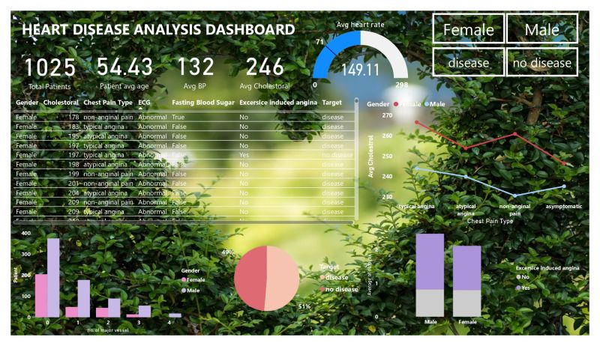

Slide 10
SPECIAL THANKS 🙏🏻 I would like to extend my heartfelt gratitude to Unified Mentor Private Limited for providing me with an incredible internship opportunity. This experience has been invaluable in furthering my professional development and gaining practical insights into the industry. The supportive and dynamic environment fostered by Unified Mentor Private Limited has enabled me to enhance my skills, gain hands-on experience, and contribute meaningfully to ongoing projects. The guidance and mentorship provided by the team have been instrumental in shaping my understanding and application of theoretical knowledge. Thank you, Unified Mentor Private Limited, for this enriching opportunity and for playing a pivotal role in my career journey.

